Slide 2
This power point presentation was created by
Mark R. Wright, OD, FCOVD
Copyright 2016 – Progressive Publishing Company – All rights reserved

Slide 3
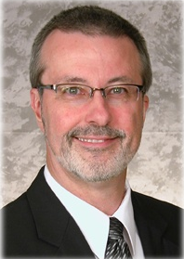
Mark Wright, OD, FCOVD
CEO: Pathways to Success for Optometrists
mwright@pathways-o.com
Editor: Review of Optometric Business
reviewob.com
CEO: Practice Management Center
thepmc.net optometrymatch.com
Board: Association of Practice Management Educators
optometrybusiness.com
Director of the OSU College of Optometry Business Management Program
Author: Coding, Reimbursement and Contracting for Optometry
1980 – 2007 founder and senior partner Professional VisionCare, Westerville, Ohio
Notes:
3
3
Dr. Wright is a 1980 graduate of The Ohio State University College of Optometry, where he is clinical assistant professor and faculty coordinator of OSU’s Business Management Program. Retired from practice last year, Dr. Wright is president of Pathways to Success, Eyecare Business Training and Progressive Publishing Company. All three of these companies are dedicated to the special practice management needs of eyecare practices. Dr. Wright has lectured extensively throughout the U.S. and abroad. His topics include not only practice management, but also managed care, sports vision and vision and traumatic brain injuries. He is also the practice management editor for the Journal of Optometric Vision Development. This is Mark’s first presentation to the MBA. Please welcome Mark Wright…

Slide 4
SPEAKER FINANCIAL DISCLOSURE STATEMENT
Mark R. Wright, OD, FCOVD has been a paid speaker for the following companies:
Alcon
B&L
ESSILOR
Jobson
Vistakon
VSP
He is an officer of:
Pathways to Success
Practice Management Center
Association of Practice Management Educators
Progressive Publishing Company
He is the professional editor of:
Review of Optometric Business
Diversified Ophthalmics
Eye Recommend
IDOC
IVA
PECAA
PERC
Vision Source

Slide 5
8:30
10:30
11:30
12:30
2:30
4:30
2016

Slide 6
S

Slide 7
Action Plan
What | Who | Success | Date | Resources | Obstacles

Slide 8
What is the MBA program
New
&
Established
Notes:
Gathering data from optometric practices since 2005
The largest database of its kind
Includes practices across the entire spectrum of size & characteristics
New and Established practices

Slide 10
Revenue mix
Staffing philosophy?
How do you define success?
Age of your practice
Size of your practice
VARIABLES

Slide 12
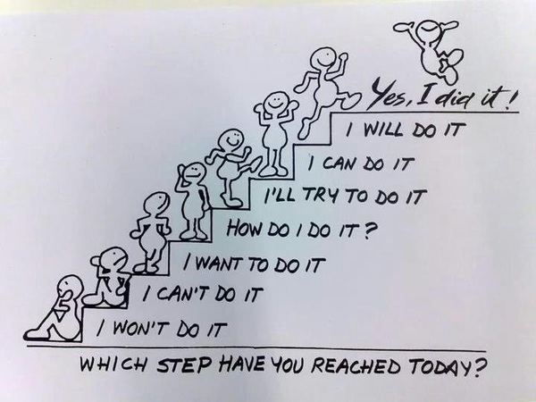
WHICH STEP DO YOU WANT TO REACH TODAY?

Slide 13
Size of the practice
1 OD: <$500K $550K-$749K >$750K
2 OD or +: <$750K $750K-$1.49M >$1.5M 1 location
2 OD or +: <$1M $1M-$1.49M >$1.5M 2 or + locations

Slide 14
A walk through your Practice Profile Report 1) Compare your results to Benchmarks 2) Discuss levers to improve the numbers 3) Create an ACTION PLAN
Practice
Profile
Report

Slide 40
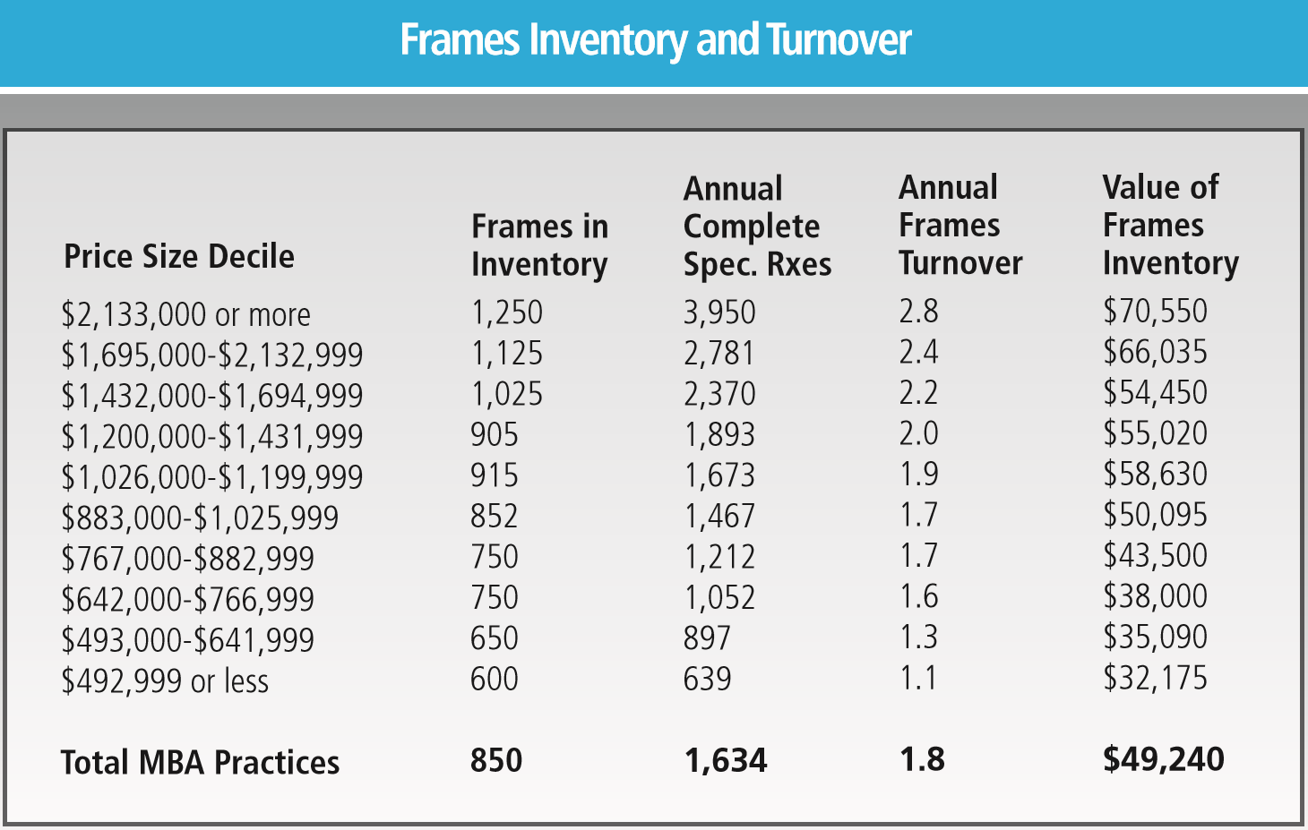

Slide 58
/

Slide 60
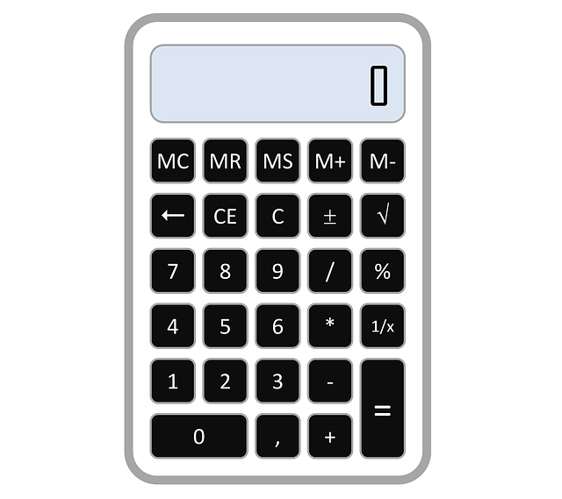
75%
-
Gross Revenue
Cost of Goods
Gross Profit

Slide 61
Reactivation of Inactive Patients
Established Patients Active
Established Patients Inactive

Slide 62
/

Slide 63
/
Total OD Hours
1 Full Time OD

Slide 64
/

Slide 66
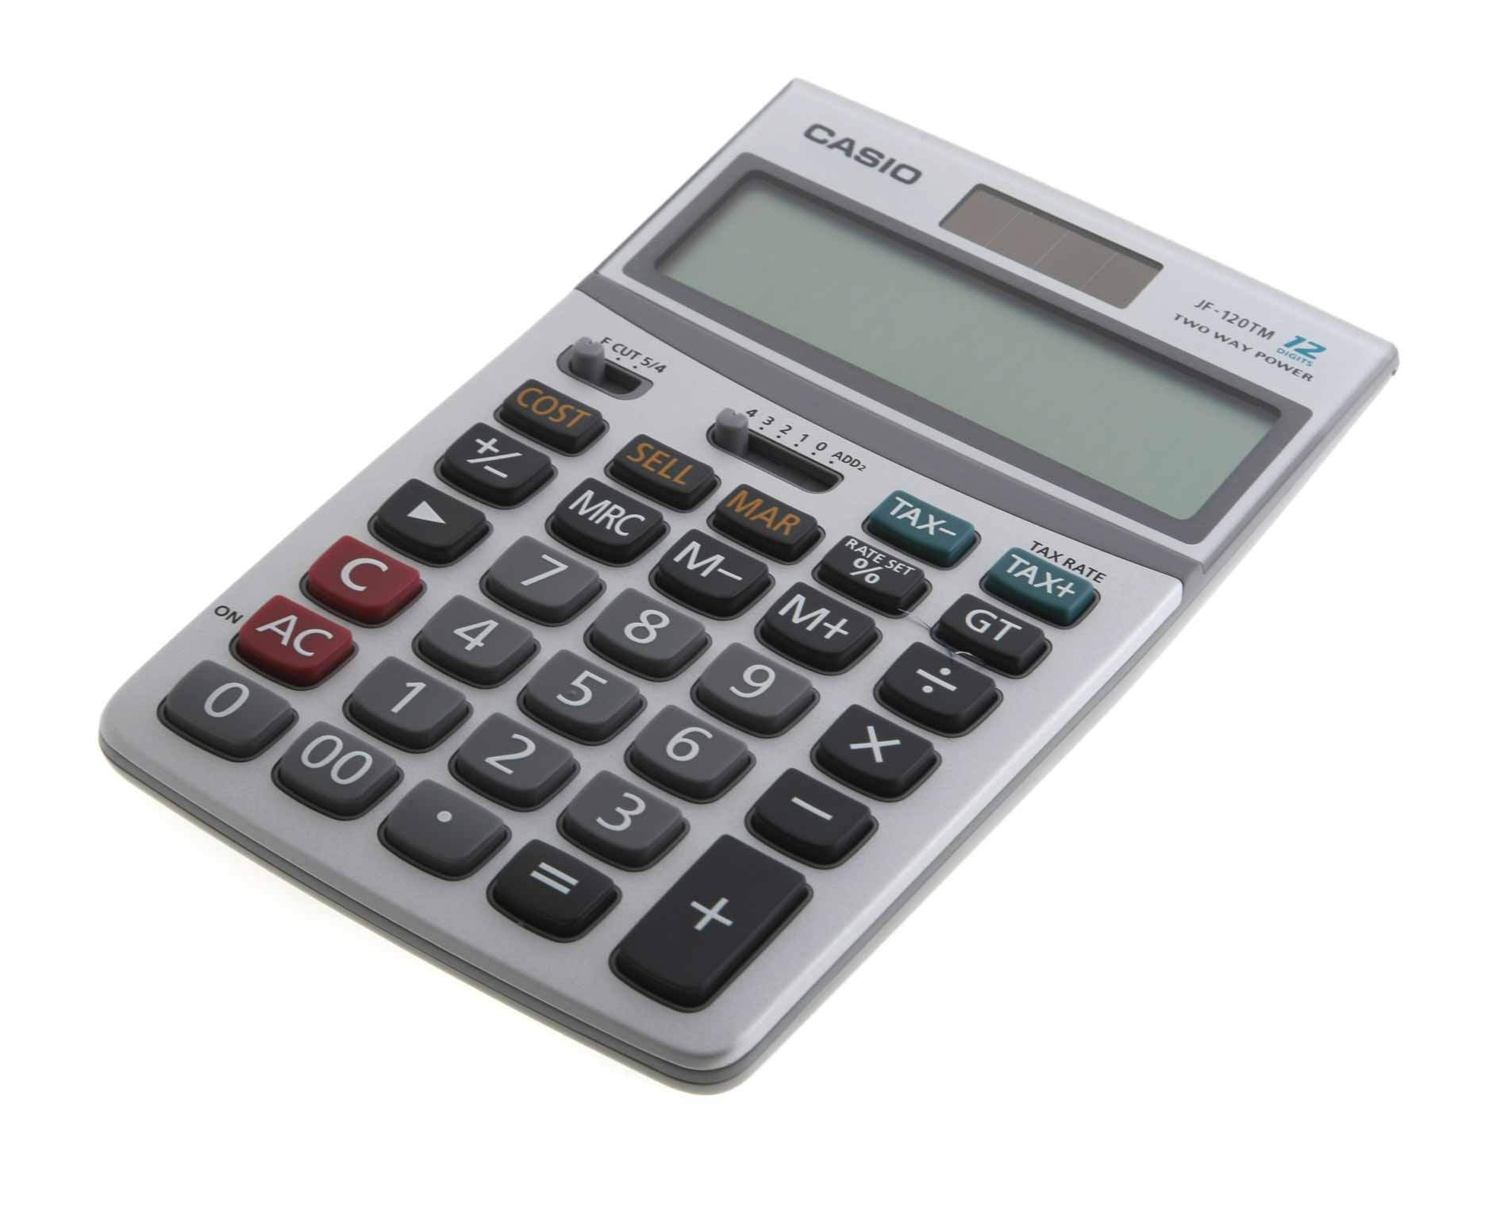
Number of staff members

Slide 67
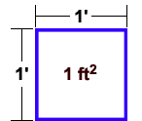
/

Slide 68
The metrics are divided into 7 groups
Total Practice Productivity
Eyewear
Contact Lenses
Medical Eyecare
Marketing
Financial
Best Practices

Slide 73
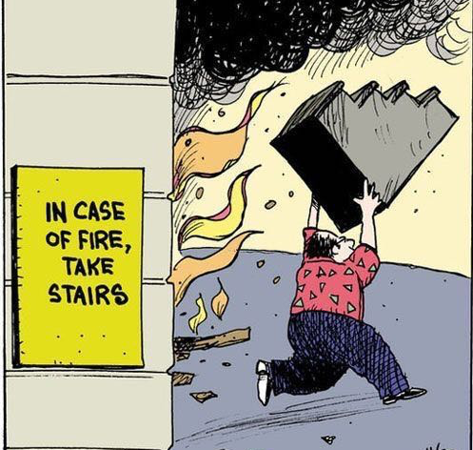

Slide 74
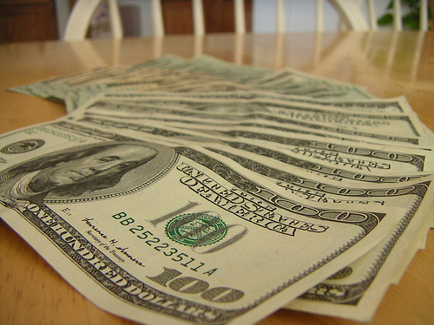
Eyewear Purchase with no Rx change

Slide 75
Level of Medical Eyecare Involvement

Slide 77
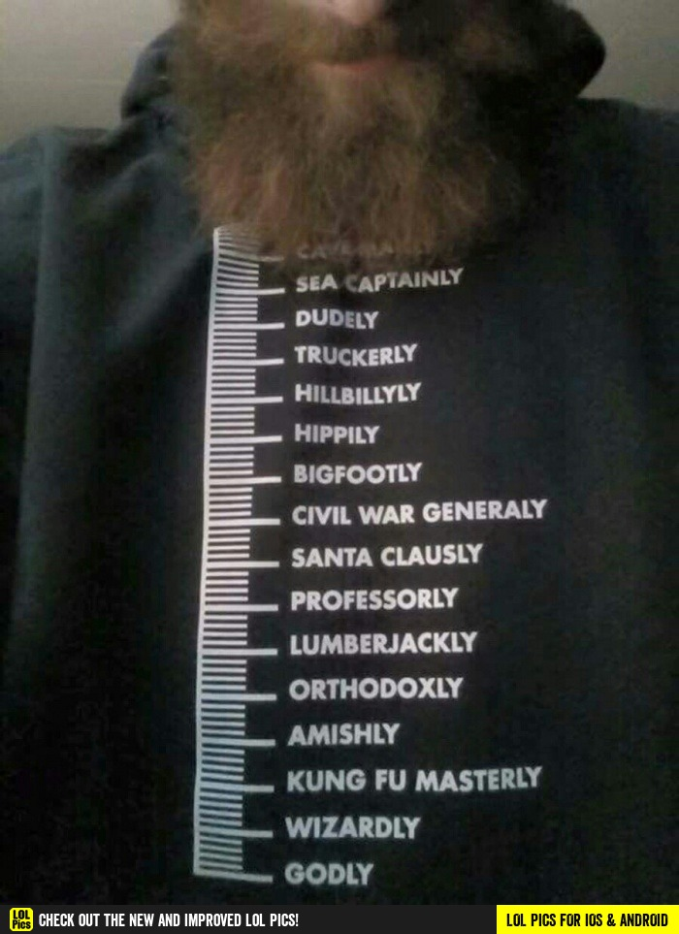

Slide 86
The metrics are divided into 7 groups
Total Practice Productivity
Eyewear
Contact Lenses
Medical Eyecare
Marketing
Financial
Best Practices

Slide 89
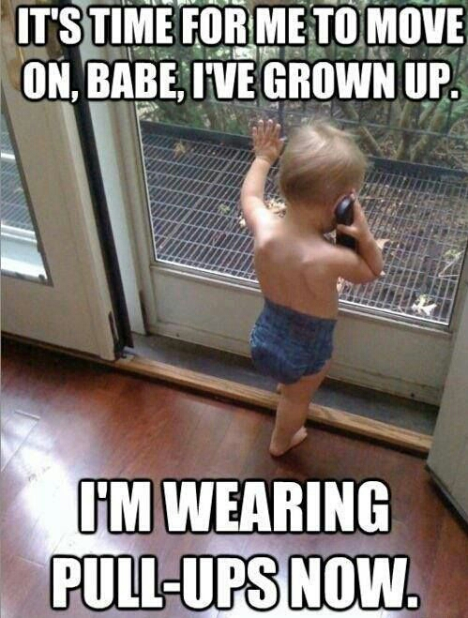

Slide 105
The metrics are divided into 7 groups
Total Practice Productivity
Eyewear
Contact Lenses
Medical Eyecare
Marketing
Financial
Best Practices

Slide 111
The metrics are divided into 7 groups
Total Practice Productivity
Eyewear
Contact Lenses
Medical Eyecare
Marketing
Financial
Best Practices

Slide 113
Marketing
External
Internal
Current patient to return
Increase $/Patient
Current Patient to refer New Patient
New Patient in Chair

Slide 120
The metrics are divided into 7 groups
Total Practice Productivity
Eyewear
Contact Lenses
Medical Eyecare
Marketing
Financial
Best Practices

Slide 136
The metrics are divided into 7 groups
Total Practice Productivity
Eyewear
Contact Lenses
Medical Eyecare
Marketing
Financial
Best Practices

Slide 146
Action Plan Step 1: Create your Action Plan List Step 2: Prioritize your List Step 3: Define Success Step 4: Set a Date Step 5: Assign a Project Manager (Who – Cannot be You)
What | Who | Success | Date | Resources | Obstacles

Slide 147
MBA Goals from Previous Meetings
FINANCIAL
Increase revenue - $1M at year 3
Add Care Credit at reception
Teach staff to say “contributes” not “covers”
Create and follow Profit Centers
Manage our expense categories
Change categories in P&L statement

Slide 148
MBA Goals from Previous Meetings
STAFF
Increase staff communication via regular staff meetings and team building skills
Make sure each staff member understands and can explain their “end product”

Slide 149
MBA Goals from Previous Meetings
OPTICAL
Offer single use CLs before going into the optical
Increase my capture rate
Implement 5 Steps in Optical Plan (polarized lens demonstration)
Implement package pricing
Implement Minimum Frame Pricing
Buy close-out frames
Reassess frame pricing
Re-evaluate frame mix
Implement Merchandising concepts in optical
Maximize payments with VSP

Slide 150
MBA Goals from Previous Meetings
OPTICAL
Increase 2nd pair sales
Create bullet points for opticians to touch on with every patient
Improve our eyeglasses guarantee
Put all name brand frames together
Evaluate what frames we are selling (conservative, contemporary, fashion forward)
Use frame vendors to help manage frameboards
Order stickers for all frames that can be used for sunglasses
Implement My On-line Optical
Implement frame order presentation plan

Slide 151
MBA Goals from Previous Meetings
PRACTICE MANAGEMENT
Implement internal number management via regular reports
Set goals for the year - review at weekly office meetings, implement staff bonuses/motivate staff
Learn how to work smarter, not harder
Create Horizontal and Vertical Exit Strategies
Improve Case Presentation
Update social media
Pre-appoint patients
Implement “systems” to create smoother and more profitable practice

Slide 152
MBA Goals from Previous Meetings
PRACTICE MANAGEMENT
Identify our top 20% patients and spoil them
Track questions from patients
Tell patients how I am addressing their concerns, explain condition, validate their concerns, prescribe return
Reward good behavior
Utilize reviewob.com
Teach staff to say “no” in a “yes” way
“You need to see me in ___months for ___

Slide 153
REVENUE
Gross Revenue
Optical Revenue
Clinical Revenue
Optometric Net
True Net
$ Accounts Receivable
NON-FINANCIAL
# Complete Exams Seen
# Total Exams Seen
# New Patients
EXPENSES
COGS
Staff Payroll
Occupancy
Equipment
Marketing
Overhead
RATIOS
$/Complete Exam
$/Spectacle Rx
$/Staff Hours Worked
$/Doctor Hours Worked
$/FTE Staff Member
$/FTE Doctor
SPECTACLES
# Frames
# Lens pairs
Ave Frame Sale
Ave Lens Sale
# Sunglass Sales
# Computer Glasses
Overhead
RATIOS
$/Complete Exam
$/Spectacle Rx
$/Staff Hours Worked
$/Doctor Hours Worked
$/FTE Staff Member
$/FTE Doctor

Slide 155
Manage your return to the office

Slide 156
Next Steps

Slide 157
You are not alone.
We are here to help!

